Slide 1
EVALUATION FOR ENGLISH AS A SECOND LANGUAGE ELEMENTARY
Notes:
Welcome to this information capsule on evaluation in ESL at the elementary level.

Slide 2
Why do we evaluate?
Which documents should we consult?
What do we evaluate?
Notes:
Here are the three questions we will try to answer

Slide 3
Why do we evaluate?
Evaluation
Support Learning
To recognize competency development.
Notes:
Let’s look at the first question: why do we evaluate?
Evaluation serves two functions: To support learning and to recognize competency development

Slide 4
Evaluation:
Support Learning
Clear and precise communication of learning goals and evaluation criteria.
Varied feedback provided to students, with opportunities for them to correct their manifestation of understanding.
Notes:
What do we mean by supporting learning? Simply put, the teacher accompanies students as they progress in their acquisition of knowledge. Students are given clear and precise learning objectives and evaluative criteria. During the learning activities, students are provided with different types of feedback, so that they can correct and adjust their manifestation of understanding.

Slide 5
Evaluation:
Certify Learning
A grade or marker of achievement is applied to recognize competency development
Notes:
What does to certify learning mean? When the teacher decides that students have had sufficient practice, the time will come to recognize competency development

Slide 6
THE TEACHING PROCESS
TEACHING
EVALUATING
The teacher provides feedback and students provide feedback
The teacher adjusts content
The teacher plans evaluation
The teacher plans classroom activities
Clasroom activities take place
The teacher plans classroom activities
Support Learning
Recognition of competency development
Notes:
The evaluation process is not a separate activity from classroom teaching: both are integrated parts of the teaching process. The teacher plans and carries out classroom activities. During classroom activities, the teacher supports learning by providing feedback to students. The students, at their end, provide the teacher with feedback and, as a result, the teacher will adjust content. There will come a time when the teacher will decide that students are ready for the recognition of their competency, after which a new teaching process will then follow.

Slide 7
Feedback: essential communication to support learning of the competencies
Reformulation of the student’s utterances
Explicit correction of the student’s utterances
Feedback offering metalinguistic clues
Asking the student to clarify the utterance
Notes:
Offering students feedback is essential, since it is used to inform and stimulate learning. By offering feedback we help students situate themselves with regards to their expression of learning, which allows them to be become autonomous and self-regulating learners.

Slide 8
... and essential communication support learning of cross-curricular competencies
Uses information
Solves problems
Communicates appropriately
Adopts effective work methods
Notes:
Providing feedback will also support the acquisition of cross-curricular competencies, a few of which are shown here

Slide 9
Which documents should be consulted?
Notes:
Our next question is which documents should be consulted to plan our teaching process?

Slide 10
Which documents should be consulted?
Ministerial Documents for Elementary ESL
Education Program
Framework for the Evaluation of Learning
Progression of Learning
Notes:
Three essential documents will accompany teachers as they plan learning for Elementary ESL. The Quebec education program, the framework for evaluation of learning, and the progression of learning.

Slide 11
What should we evaluate?
Notes:
It is by consulting these three documents that we will be able to adjust our aim, and target learning objectives more fairly and precisely for each cycle and grade. These three documents will help to answer the next question which is what should we evaluate?

Slide 12
What should we evaluate?
C1: To act on understanding of texts
60%
C2: To interact orally in English 40%
Cycle 1
Notes:
Let’s begin with cycle one. The program informs us that students will develop two competencies during grades 1 and 2, C1 To act on understanding of texts and C2 To interact orally in English

Slide 13
Competency 1:
To act on understanding of texts
60%
Cycle 1
Notes:
For cycle 1, C1 aims to guide students through a discovery of the English language. What does this look like in practice?

Slide 14
«Students demonstrate understanding of authentic texts»
« Students make links between words, visual support and other resources »
« Guided by the teacher, students (…) have the opportunity to monitor their own learning »
Cycle 1
Notes:
Students are given the opportunity to demonstrate their understanding of authentic texts. Students make links between words, support and other resources and as they are guided by the teacher, students have the opportunity to monitor their own learning.

Slide 15
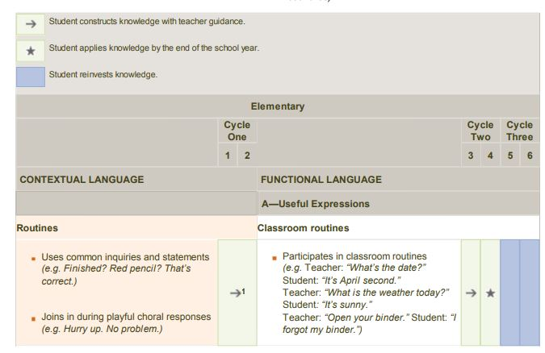
Cycle 1
Notes:
The progression of learning informs us about the learning expectations for each grade and cycle. It is important to note that the use of arrows has a different meaning for cycle 1. Indeed, for this cycle, students develop meaning at their own rhythm and with constant support from the teacher throughout the cycle.

Slide 16
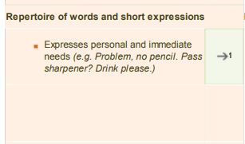
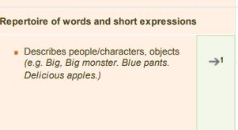
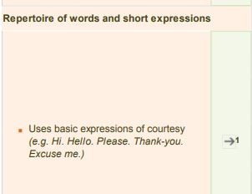
The teacher creates a learning environment for students with singing of simple songs, repetition and reuse of groups of words. Students will use these same words to express themselves and understanding.
Cycle 1
Notes:
We are given specific examples of how the teacher will provide students with exposure to the English language. Students will repeat words and groups of words and develop their C1 by repeating song lyrics, listening to authentic texts and using everyday short expressions.

Slide 17
C1: To act on understanding of texts.
60%
Hello!
C2: To interact orally in English
40%
I like pizza.
Help!
Goodbye
I see a cat!
I have a dog.
I like blue.
It is snowing.
Cycle 1
Notes:
At their own individual rhythm, students build a bank of words and groups of words. As the students begin to express these words, they develop C2 skills,To interact orally in English

Slide 18
Cycle 1
Notes:
The framework for the evaluation of learning informs us about the criteria for evaluating students.

Slide 19
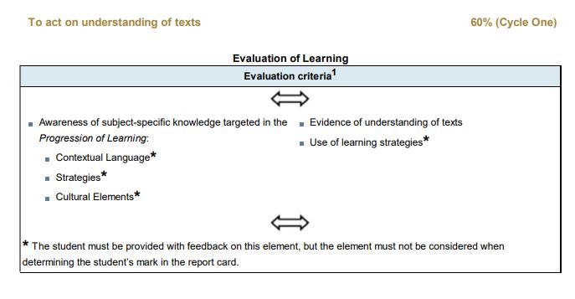
*Teaching that supports learning*
Teaching that supports and recognizes competency development
Cycle 1
Notes:
For competency 1 in cycle 1, certain items are taught in order to support learning, such as contextual language, strategies and cultural elements, whereas other items are taught to support and recognize competency development, in this case evidence of understanding of texts. It is important to understand that including all of the above items in the teaching process will allow for a more supportive and complete learning experience for the students. Furthermore, there is a constant back and forth between evaluative items.

Slide 20
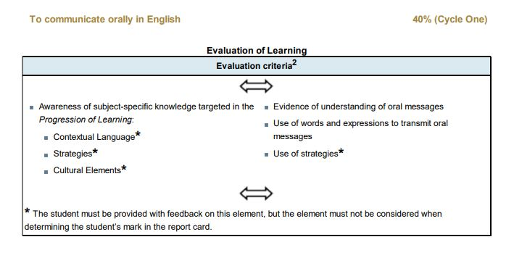
Support and recognize competency development
Support
Support
Cycle 1
Notes:
Teachers will explain learning strategies, and connections will be made between teaching content and cultural elements so as to support learning. Students will participate in activities through which they will be able to demonstrate their knowledge.

Slide 21
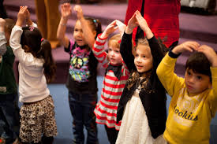
How to develop c1: To act on understanding of texts:
Students develop their ability to act on their understanding of texts by learning songs with gestures. Through repetition, students understand the meaning of words and can separate them from the songs and reuse them in other contexts.
Cycle 1
Notes:
Students are able to act on their understanding of texts by learning songs with gestures. Through repetition, students understand the meaning of words and can separate them from the songs and reuse them in other contexts.

Slide 22
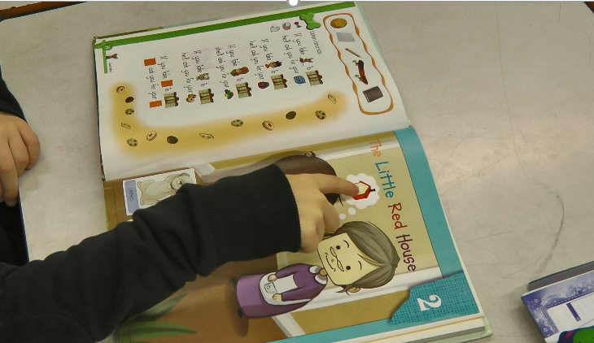
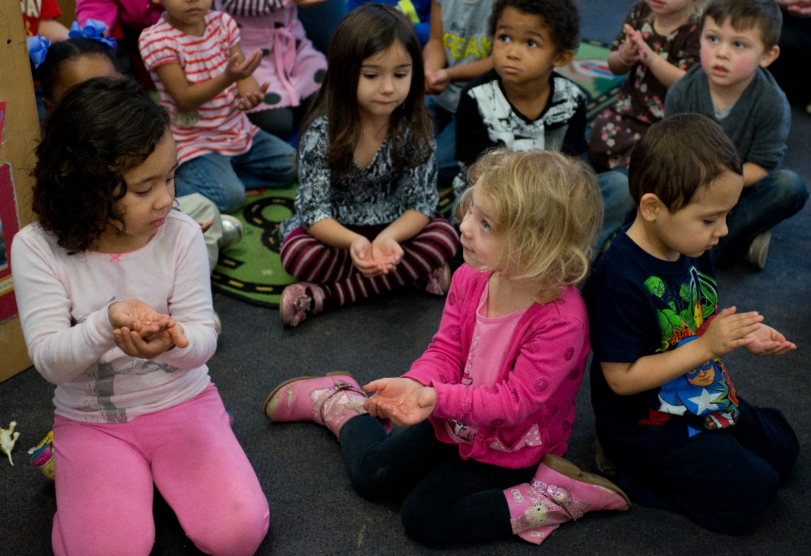
How to observe c1: To act on understanding of texts:
Lunch Box, La Porta, F. & Mallais, J. Pearson-Erpi, 2007. ISBN: 978-2-7613-2566-0
Cycle 1
Notes:
The teacher can ask students to act on their understanding of texts by pointing, by putting up their hands or by gesturing, individually or in groups.

Slide 23
Point/Put your hands up if…/Stand up or sit down if…
E.g.
Point to the …
Put your hands up if you see a…
What do you see?
Stand up if you have a … Sit down if…
Where is the…
I see a …, Do you see a… (point to the …)
Cycle 1
Notes:
Teachers keep students concentrated and focused by constantly asking them to interact with the learning content..

Slide 24
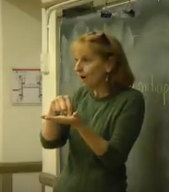
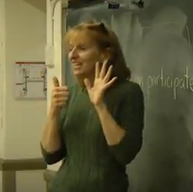
The teacher explains learning strategies
« Point to the object »
« Follow the teacher »
« Ask for help »
Cycle 1
« Concentrate »
Notes:
Teachers explain learning strategies.

Slide 25
Elementary ESL Program Cycles 2 and 3
Notes:
Now let’s take a look at the elementary ESL program for cycles 2 and 3

Slide 26
Elementary ESL Competencies | Cycle 2 | Cycle 3
C1 To interact orally in English | 50% | 45%
C2 To reinvest understanding of oral and written texts | 35% | 35%
C3 To write texts | 15% | 20%
Cycles 2 & 3
Notes:
For cycles 2 and 3, there are 3 competencies…

Slide 27
C1 To interact orally in English
C2 To reinvest understanding of oral and written texts
C3 To write texts
Cycles 2 & 3
Notes:
The three ESL elementary competencies have been separated to better define them, but as one competency is focused on in classroom activities, the two others are also being developed. Furthermore, when learning activities are initiated for competencies 2 or 3, C1 activities are often used to activate learning.

Slide 28
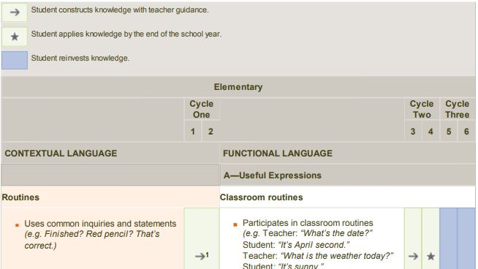
Cycles 2 & 3
Notes:
The legend in the Progression of Learning is different from cycle 1. An arrow indicates that the student constructs learning with teacher guidance, a star indicates that the student applies knowledge by the end of the school year and the blue highlighting tells us that the student is reinvesting knowledge. For the category of useful expressions, we can see that a grade 3 student is still constructing knowledge with the teacher’s guidance, whereas a grade 4 student will have applied this knowledge by the end of the year. Finally grade 5 and 6 students are reinvesting this knowledge, which was evaluated in grade 4.

Slide 29
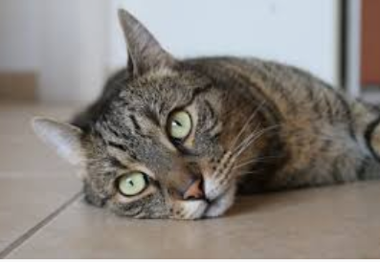
Example: Pets : a typical elementary cycle 2 theme
Information given to the students: | Connection to the Progression of Learning: | Grade 3 | Grade 4
1. You will know the names of 10 pets. | “Uses targeted vocabulary to carry out tasks”
2. You will describe each pet (colour and size). | “Places adjectives before nouns (e.g. red car, beautiful day)”
3. You will spell words correctly. | “Spells words as found in explicit models and resources targeted for carrying out tasks”
Cycles 2 & 3
Notes:
To further illustrate the teaching process, let’s look at this example of a lesson on pets. The learning objectives are clearly defined and presented to students before the activities begin. These same learning objectives will be referred to during learning activities and for evaluation purposes. Based on this small example, we can see that grade 3 students will be supported by teachers throughout the year, whereas grade 4 students will be expected to show competency development for items 2 an 3

Slide 30
C1 To interact orally in English 50% C1 is the competency that much class time and teacher support will be dedicated to.
C1 To interact orally in English
Put your hands up if you have a domestic animal.
Put your hands up if you like cats, dogs, hamsters.
What other animals do you like?
Look at the image, what do you see?
Yes, a cat. What colour is it?
Name a characteristic (whiskers, fur, tail, claws).
Does it have a tail? Does it have fins?
Can you describe one of these pets? Can you describe your pet?
Two by two, pick a pet each and ask questions to guess what it is.
Describe your pet to me.
Cycles 2 & 3
Notes:
Competency 1 is given the most weight, and therefor the competency for which teachers will offer the most support and practice. By constantly eliciting language from students, by asking questions and creating opportunities to practice though games and activities.

Slide 31
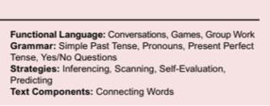
Resources
Cycles 2 & 3
Poptropica English, Romano, A. & Mallet, K. Pearson-Erpi, 2018. ISBN: 978-2-7613-7721-8
Notes:
Activity books approved by the ministry will provide properly adjusted and true to level evaluative criteria.

Slide 32
THE TEACHING PROCESS
TEACHING
EVALUATING
The teacher provides feedback and students provide feedback
The teacher adjusts content
The teacher plans evaluation
The teacher plans classroom activities
Clasroom activities take place
The teacher plans classroom activities
Support Learning
Recognition of competency development
Notes:
To conclude, evaluation and teaching are not two separate events. They are integrated parts of the teaching process, which, along with a consultation of the mentioned ministerial documents, will allow for a fair and precise evaluation of competencies.

Slide 33
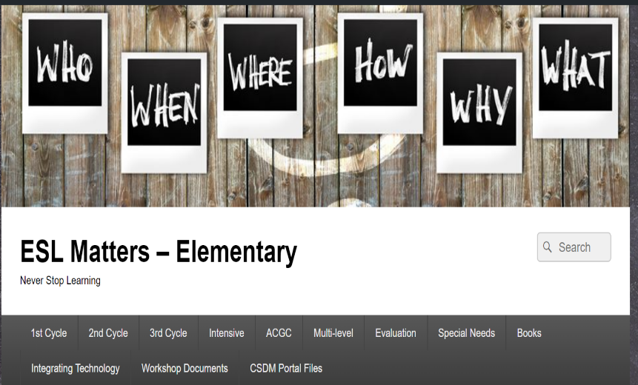
RESOURCES
ESL cycle 1 program | ESL cycles 2 & 3 program | Framework for the evaluation of learning
FREE CSDM NUMERIC RESOURCES | ESL MATTERS ELEMENTARY BLOG | Progression of learning
Notes:
Here are the essential resources support the planning of learning activities

Slide 34
For more information:
Elementary ESL pedagogical counsellor
Bureau de l’expertise et du déploiement pédagogique II
Services pédagogiques CSDM
(514) 596-4220, extension 6155
Notes:
For more information, or additional support, do not hesitate to contact your pedagogical counsellor, at the office of pedagogical services.

